Slide 1
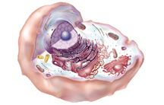
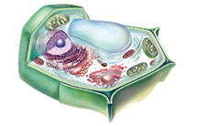
Section 3
Cellular Structure and Function
Structures and Organelles
Plant and Animal Cell Structures
Animal Cell
Plant Cell
Cellular Pursuit

Slide 2
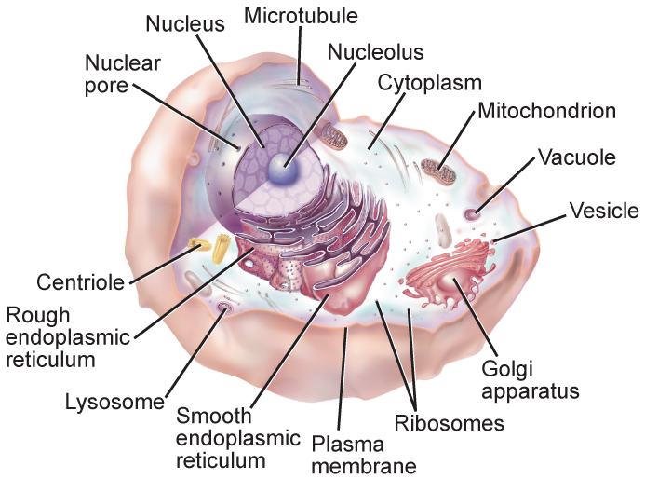
Section 3
Cellular Structure and Function
Structures and Organelles

Slide 3
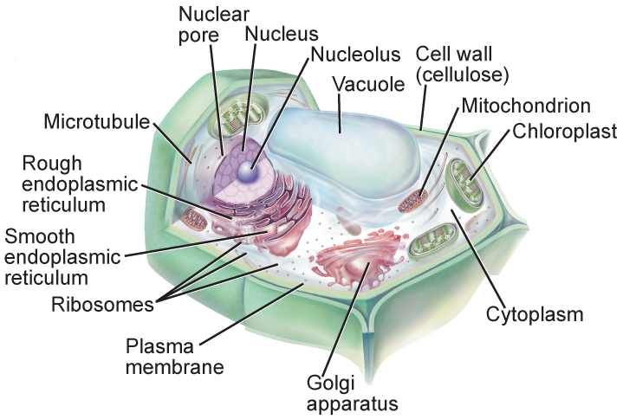
Section 3
Cellular Structure and Function
Structures and Organelles

Slide 4
Section 3
Cellular Structure and Function
Structures and Organelles
Cilia
Short, numerous projections that look like hairs
Flagella
Longer and less numerous than cilia
Create movement with a whiplike motion

