Slide 1
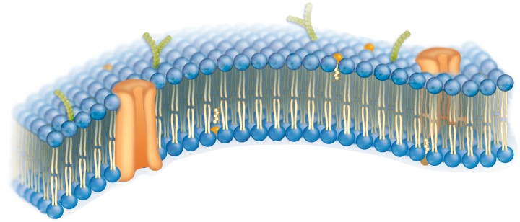
Section 1
Cellular Structure and Function
The Plasma Membrane
Plasma Membrane
Thin, flexible boundary between the cell and its environment
Allows nutrients into the cell
Allows waste to leave the cell

Slide 2
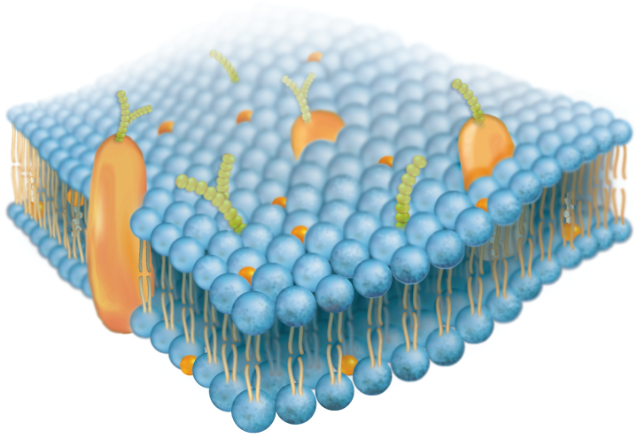
Section 2
Cellular Structure and Function
The Plasma Membrane
Selective Permeability
The plasma membrane controls the movement of substances into and out of the cell.
Plasma Membrane
Controls the amount of a substance entering the cell
Controls the amount of a substance leaving the cell

Slide 3
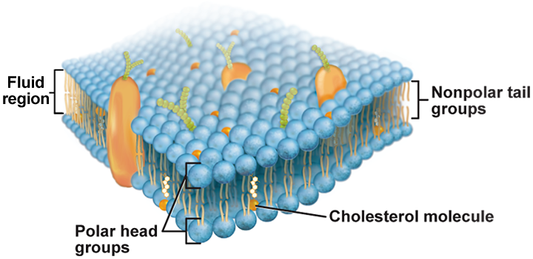
Section 2
Cellular Structure and Function
The Plasma Membrane
The plasma membrane is composed of the phospholipid bilayer.
A phospholipid molecule is composed of a glycerol backbone, two fatty acid chains, and a phosphate group.

Slide 4
Section 2
Cellular Structure and Function
The Plasma Membrane
Fluid Mosaic Model
The phospholipid bilayer allows other molecules to “float” in the membrane.
Other Components
Proteins
Cholesterol
Carbohydrates

Slide 5
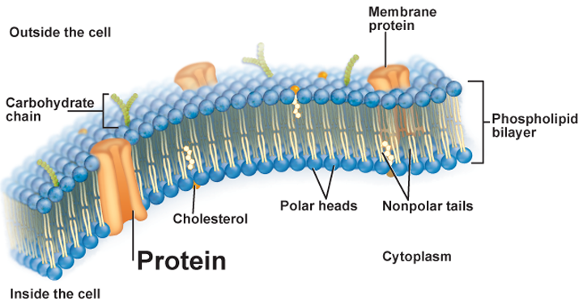
Section 2
Cellular Structure and Function
The Plasma Membrane
Proteins
Transmit signals inside the cell
Act as a support structure
Provide pathways for substances to enter and leave

Slide 6
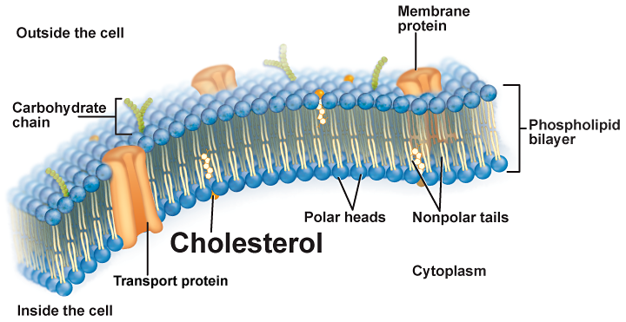
Section 2
Cellular Structure and Function
The Plasma Membrane
Cholesterol
Prevents fatty acid tails from sticking together

Slide 7
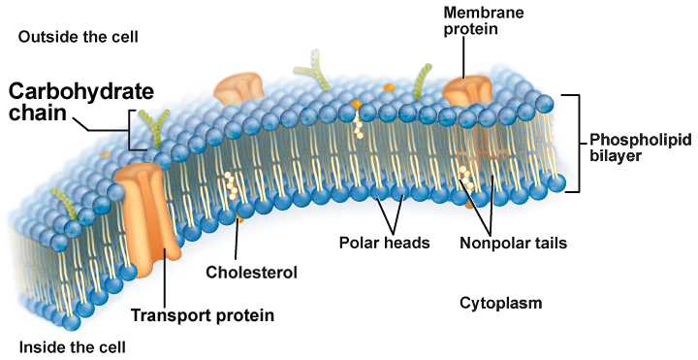
Section 2
Cellular Structure and Function
The Plasma Membrane
Carbohydrates
Identify chemical signals

